Slide 1
Early Repayment and Rate Adjustment/Reset
Center of European Policy Studies
– Brussels, October 20 2010
Hans-Joachim Dübel
Finpolconsult.de, Berlin

Slide 2
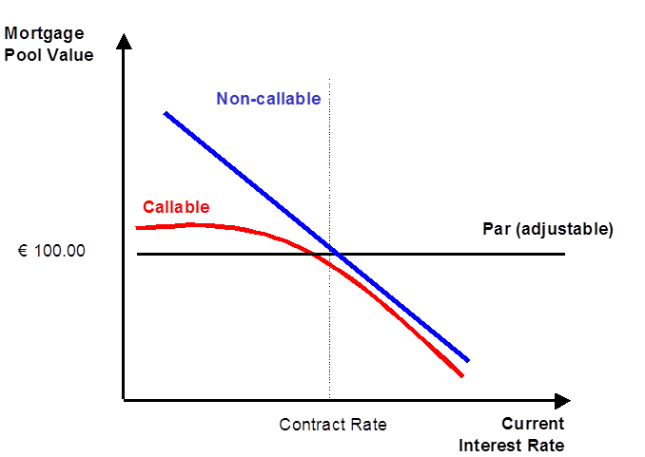
Market risk: central mortgage product design, pricing and credit issue
Adjustable-rate mortgage loan pools are always priced around E 100, as their contract rate varies with the market rate.
Fixed-rate mortgage loan pools in principle price like fixed-rate government bonds
  Rates fall below contract rate, bond price rises above E 100; if they are call protected/non-callable.
Callable fixed-rate mortgage loan pools price like non-callable fixed-rates when interest rates rise, and like adjustable-rates when interest rates fall (convexity).
Consumer protection issues
  Payment shock risk
  Adjustment via index or by lender? Rate ceilings?
  Admissible call protection (indemnity) levels?
Interest rate mechanics of
3 principal mortgage products

Slide 3
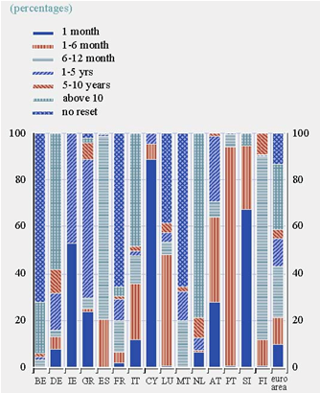
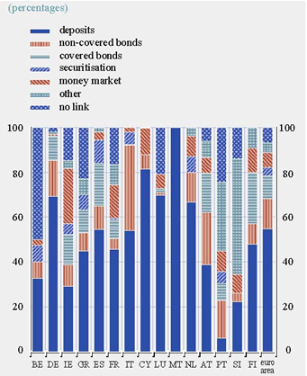
Product choice & funding in the Eurozone
Mortgage products by reset period
Mortgage funding sources
EU systems are increasingly repricing in the short-term.→high dependency on ECB
European FRM are typically reset before maturity and non-callable.
Funding is short-term, high levels of maturity/interest rate risk transf.
Source: ECB, 2009

Slide 4
Shorter reset period/lower amortization = higher payment shock risk
Yield curve as pricing benchmark for reset. Europe today mostly ARM (except France, Belgium, Netherlands, Germany).
Forex (CEE) and inflation-linked (fmr CEE, Iceland, Latin) as negative amortization variants of ARMs.
Switch from French amortization to IO/bullets (Spain, Netherlands)
As house prices rise, products with payment shock risk boom cyclically, exacerbating credit risk (risk layering).

Slide 5
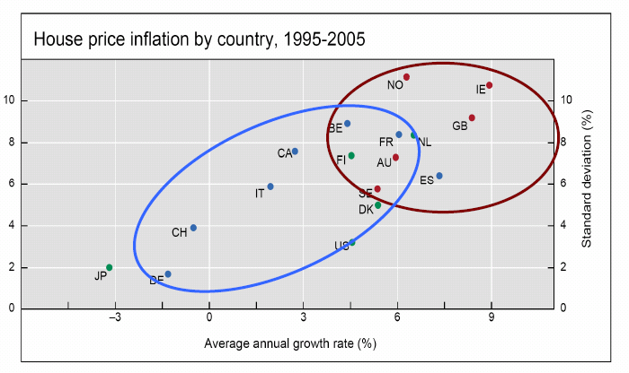
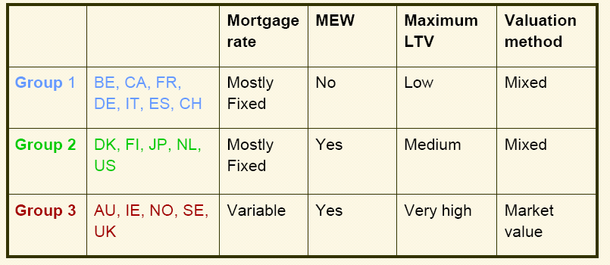
Aggressive products may be also causal for house price inflation
Explaining inflation/volatility:
- Product type
(discount factors)
- Equity withdrawal options
- High-Loan-to-Value markets
- Valuation methods
Regulatory issue:
Misalignment of industry and consumer incentives.
E.g. excessive valuation.
Source: BIS/ Zhu & Tsatsaronis

Slide 6
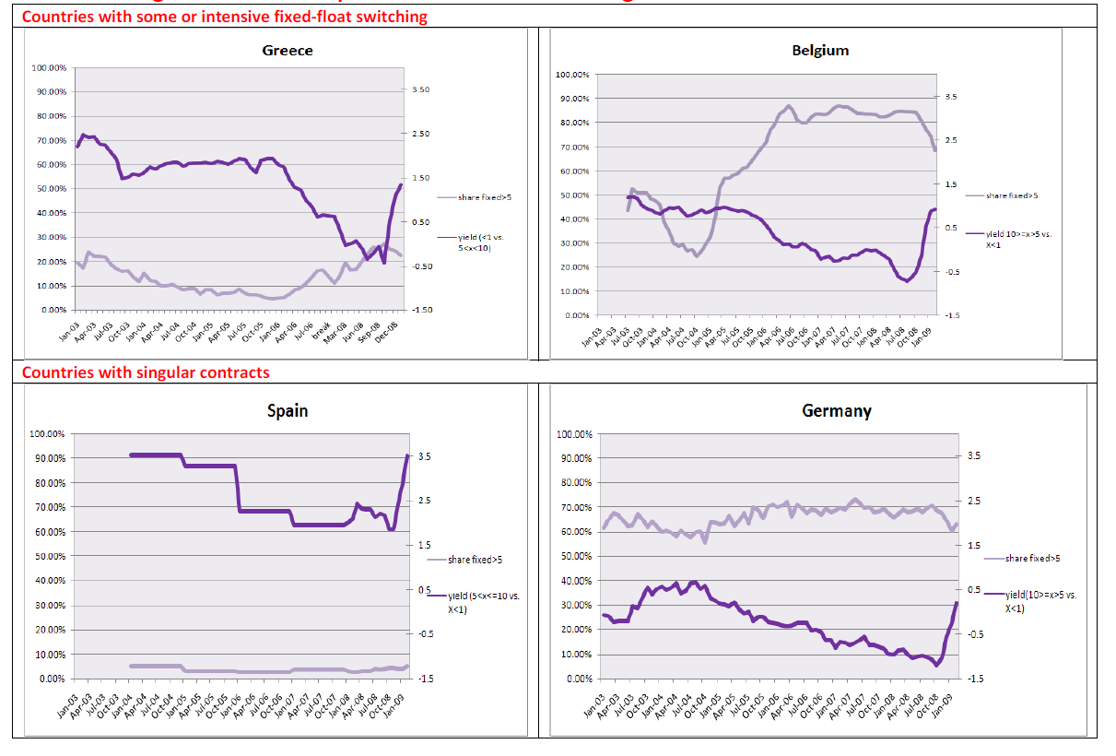
EU FRM-ARM demand, yield curve
Market share of FRM > 5 yrs and Mortgage Yield Curve (5-10 yrs – <1 yr)
Similarities, but vastly different product shares. What explains the differences?

Slide 7
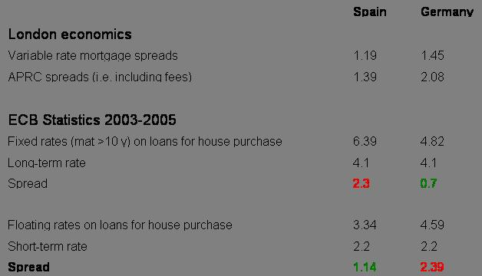
EU pricing differences, drivers
Germany vs. Denmark
Germany vs. Spain
Options: DK with prepayable fixed-rate; DE non-prepayable or call protected fixed-rate.
Consumer protection: Spain until recently limited FRM prepayment indemnities, high ARM indemnities. Germany yield maintenance for FRM, no ARM indemnities.
Supply: DE adjustable-rate bank balance sheet pricing, variable spreads; DK adjustable rate capital market pricing, constant lender spread. ES: ARM pricing over Euribor (interbank) benchmark.
Liquidity: Spain deeply liquid ARM market (lender swaps back fixed CB issued); Germany liquid non-callable FRM market.

Slide 8
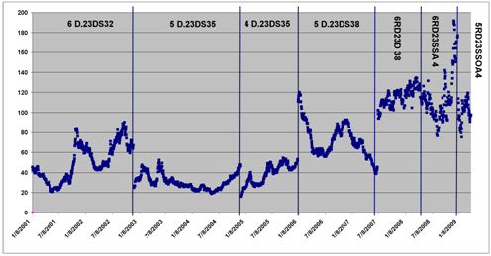
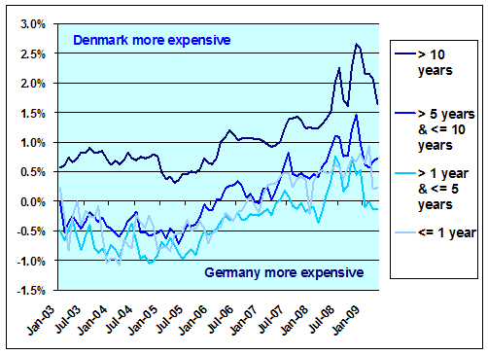
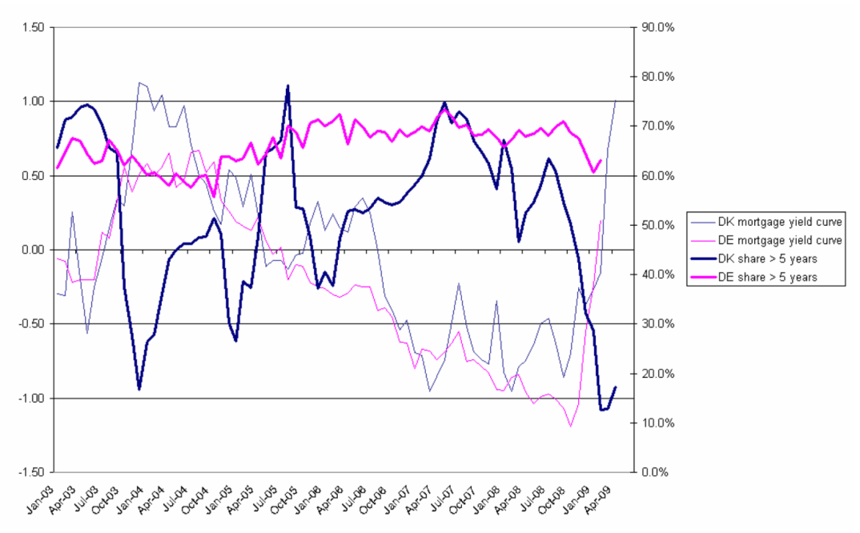
Prep option costs impact on FRM mkt share
Options cost
Case Denmark 03-09
Increasing prep options costs as implicit pension fund subsidies were withdrawn.
Strong house price increase puts pressure on affordability.
Increasing elasticity of ARM-FRM demand to yield curve changes.
System converts to ARM (as US, DK has no mezzanine LT non-callable product).
Note: German funding comparator subsidized during crisis, Danish not
Pricing relative to Germany
Market shares and yield curve

Slide 9
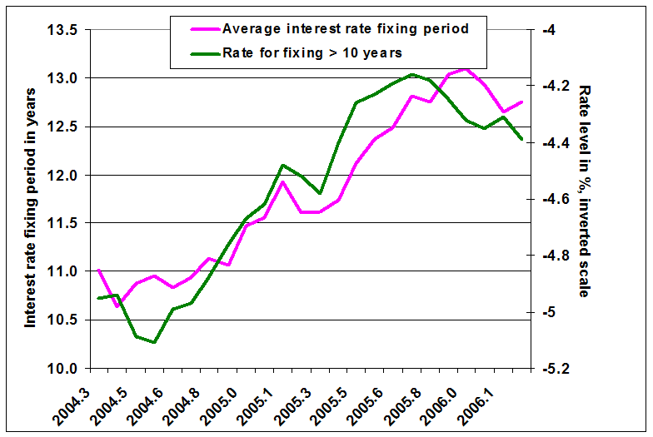
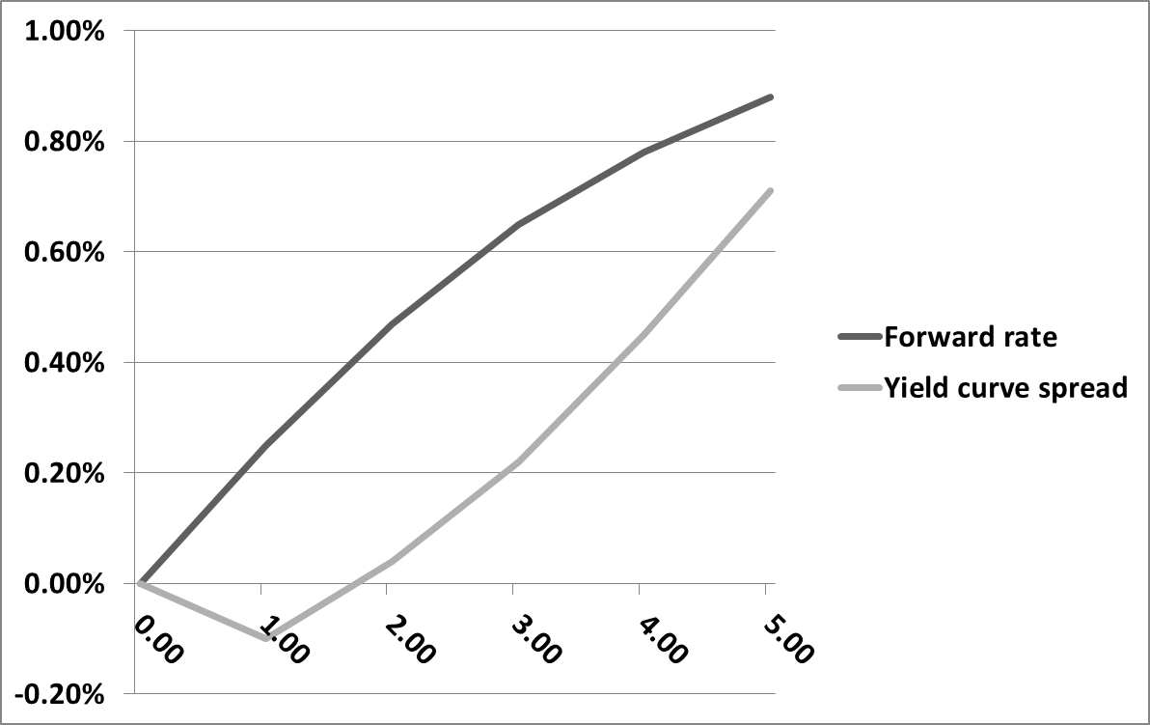
Non-callable FRM reset risk
& forward rate markets
Non-callable FRM maturities and rates, Germany
Forward rate pricing Germany 10
Non-callable markets exhibit ‘reset period cycle’ as borrowers try to gauge where equilibrium interest rate is.
Canada/Germany/Netherlands: low spreads over (gov benchmark), but the roll risk is on the borrower.
Forward rate markets can partly resolve (up to 5 yrs in Germany).
Open issue: protection credit risk premium increase (back book discrimination).

Slide 10
Non-callable FRM prepayment indemnities - conceptual
Basic regulation questions for prepayment indemnities
Interaction with legal transactions cost of prepayment
Time limit & fair value (yield maintenance) indemnity, possibly symmetric.
Volume limit (in practice, asymmetric) , efficiency of mixed pricing?
Combination with flexibility to change limits as risk situation changes?
Symmetry? Waiver in hardship cases?

Slide 11
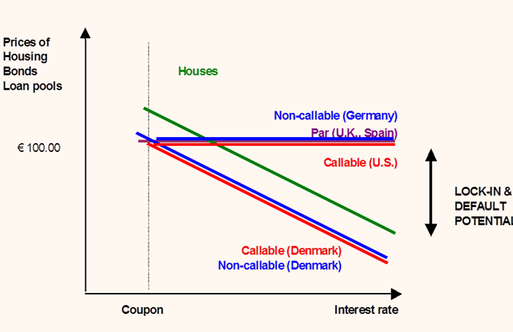
Symmetric model: debt buyback option
Denmark exercise of delivery option
Lock-in under asymmetric contracts
In a 1-1-System (one loan = one bond), consumers can act like firms. As bond prices fall (rates increase), consumers buy back their debt at the market price.
This avoids lock-in and keeps housing and bond markets liquid.
In combination with below par issuance, reduces duration risk for callable loans, benefits investors.
No reinvestment profit for lenders when rates rise.

Slide 12
Member State regulation trajectories
Note: declining rate scenario for FRM
Some systems above fair value (often on ARM; or if rates rise on FRM).
With declining inflation, pressure to reduce or eliminate indemnities.
However, counter movements (Spain).
Can fair value principle be established under max harmonization?

Slide 13
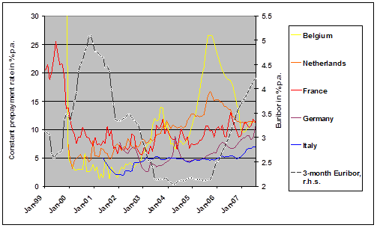
Impact of regulations on prep speeds
Prepayment speeds in 5 EU states
Prepayment speeds Portugal after 07 reform
Call protection – combination of legal transactions costs and indemnities. Hence FR lower speeds than DE.
Countries with high legal costs tend have low indemnities & vice versa (FR, IT).
Removing indemnities can lead to singularity in callable FRM, large cross-subsidies.
Margin risk additional factor, higher speeds will lead to proportionally higher upfront fees (affordability impact).

Slide 14
Prepayment matters in crisis for default performance
US Prime and Alt-A Fixed Rate Voluntary Annualized Prepayment Speeds
US Prime and Alt-A Fixed Rate Annualized Default Transition Rates
Source: LoanPerformance, Amherst Securities
Notes:
Monthly Book Updates December 2009 01042010.xlsx
(11)primearm cltv

Slide 15
European ARM
Index-trackers vs. reviewable rates
UK, spreads of index trackers vs. standard (lender-reviewable) variable rate product
EU legal comparison ca 2005
Source: Bank of England, Finpolconsult computations.
Compulsary indexation may increase volatility. Market may tilt to single instrument (Spain). Reviewable with unsolved CP issues (downward adjustment).
Caps practiced primarily where fixed-rate mortgages already exist.
Minimum interest rate practices, forced float-fixed swaps (Spain).

Slide 16
US MBS: mispricing of (teaser rate) ARM dominates securities markets problems
ARM (in US mostly with teasers) more severely mispriced than FRM and than Subprime.
Option ARM (product innovation) more severely mispriced than Subprime
(credit innovation).
As house prices ballooned (06/7 cohorts), ALL products became mispriced.
Note: data indicate mispricing of RMBS, i.e. net of basic credit assumptions/pricing.

Slide 17
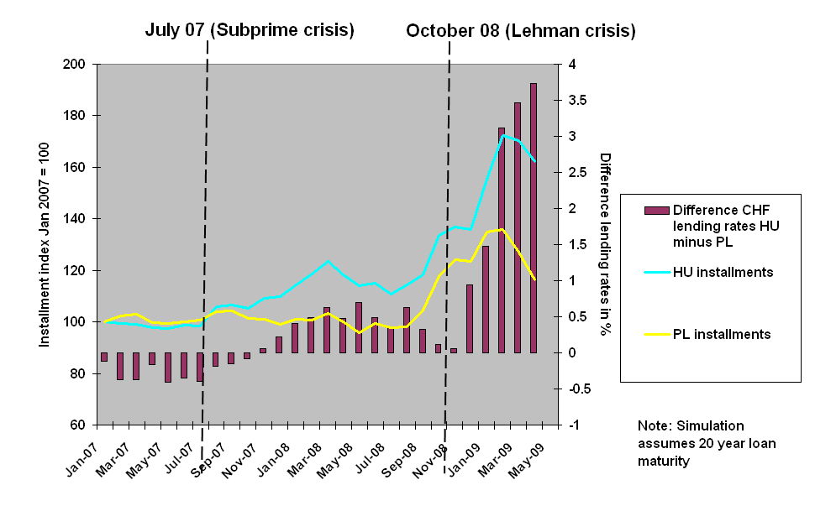
European ARM: Forex lending in Poland and Hungary
Interest rate and installment differentials 2007 cohort
CHF vs. local currency delinquency rates
Source: forthcoming World Bank report, Duebel/Walley.
Polish banks mostly tie CHF rates to a CHF money market index; this creates what one could dub ‘policy hedging’, i.e. a bet on Swiss central bank action.
Hungarian banks practice “reviewable” CHF rates, i.e. pass through funding cost changes; result is lower cost of funds risk bought by higher default risk.

Slide 18
The open product regulation/ preference debate
Issues:
Consumer protection vs. affordability (e.g. indemnities)
General lending standards and capital requirements
Supply constraints (e.g. prep option, forward market).
U.S.
07 Interagency guidance (FIFA)
Dodd-Frank→product preference re ‘skin in the game’. Federal banking agencies, the SEC, the Secretary of HUD and the Director of the FHFA to jointly define the term “qualified residential mortgage”
BIS
Mortgage underwriting standards, forthcoming
Capital requirements favoring FRM?
EU
Numerous failed efforts to transpose even limited CCD canon (early repayment, rate adjustment, assignment)
White Paper: will not touch material CP issues (part of CCD), indirect via responsible lending?
Member States
UK FSA to consider cumulative effects of products with amortization and underwriting issues (LTV etc).
Spain initiative re minimum rates in ARM contracts?
Hungary/Poland severely curtailed CHF and partly EUR lending.
Other
Iceland to ban negative amortization product ex post (banks to bear losses)
→it will never happen on the EU level
→proposal overleaf.

Slide 19
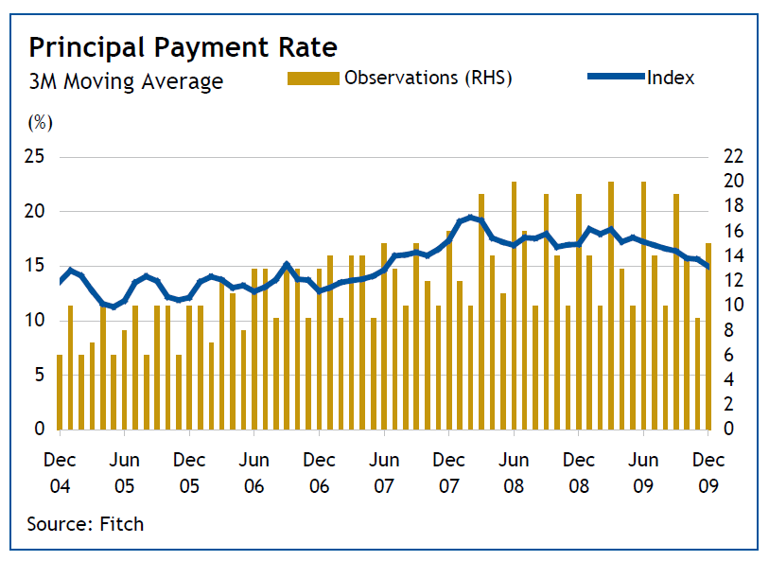
How much tolerance does the EU have for ad-hoc policies?
Italy – retroactive Bersani decree 2007
2007: Prepayment indemnities abolished, CPRs of fixed-rates almost double.
2007: 2003-06 ARM wave, government reacts to increasing rates by giving consumers right to defer payments above 2006 max.

Slide 20
EU-Member State Interaction on Material Cons Protection, Proposal
EU is challenged to address material consumer protection issues to fulfil mandate as competition watchdog. Proposal:
The European Union
Defines a methodology to estimate the (default/insolvency) risk exposure of consumers that purchase certain products, are exposed to certain practices.
Sets wide minimum material consumer protection rules (max harm), empirically reviewed regularly (e.g. every 10 years).
Allows Member States to require from lenders heightened disclosure within minimum where new product are introduced, for some time.
Creates an appeals process for the Member State aiming to keep or introduce stricter national material consumer protection rules based on above methodological rules.
The Member State either
accepts the maximum harmonization level, i.e. eliminates more far-reaching legislation,
Or appeals to the Commission for setting stricter national rules by providing empirical evidence within the methodological framework provided. Those national rules are subject to review on more frequent basis (e.g. every 3-5 years).

